Slide 1
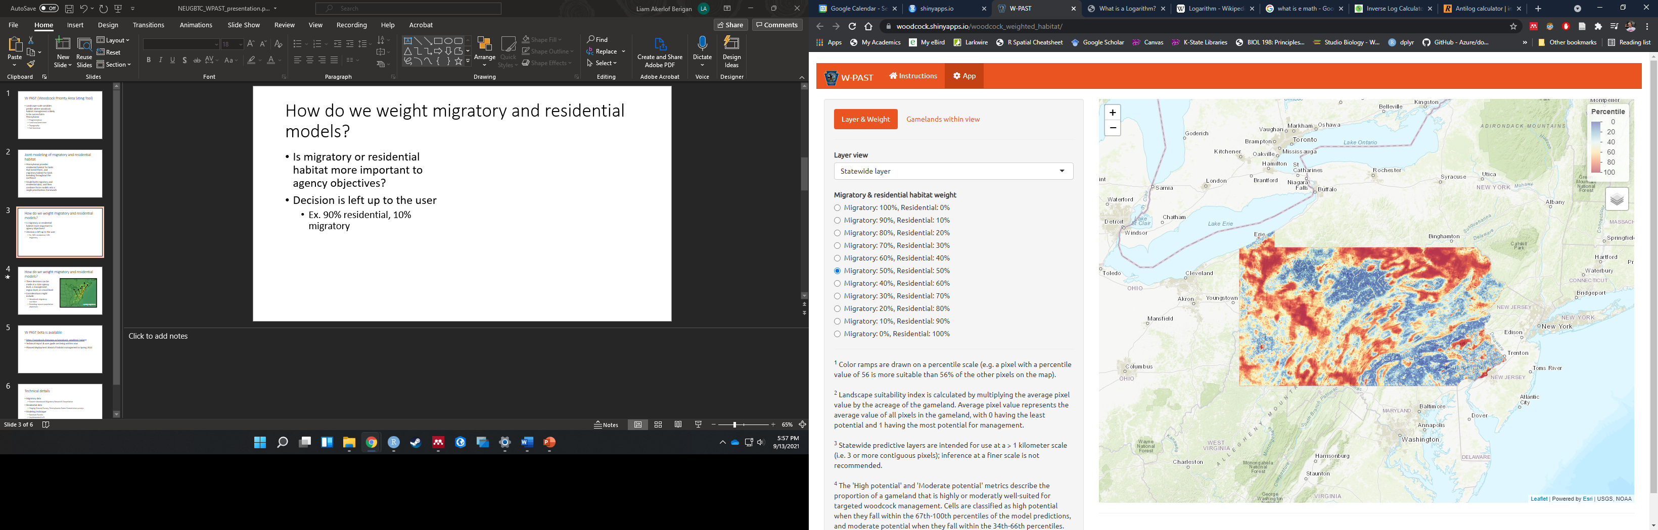
W-PAST (Woodcock Priority Area Siting Tool)
Notes:
Landscape-scale variables predict where woodcock habitat management is likely to be successful in Pennsylvania
Uses only coarse-scale landscape variables; does not take current management into account
Because of this, useful primarily at a >1 km scale
Goal: determine where to apply new woodcock management

Slide 2
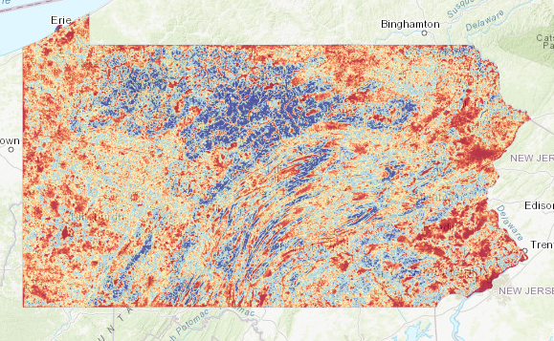
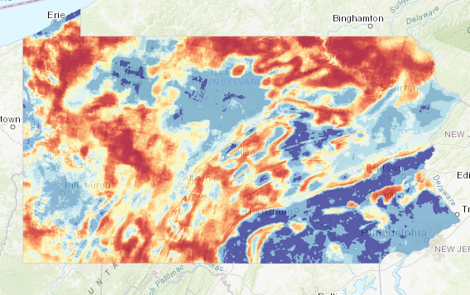
Combined migratory and residential model
Weighting decision
e.g. 50:50
Multi-season model
Migratory
Residential
Notes:
Pennsylvania provides residential habitat for birds that breed there, and migratory habitat for birds breeding throughout the northeast
Model both migratory and residential data, and then combine those models into a single prioritization framework

Slide 3
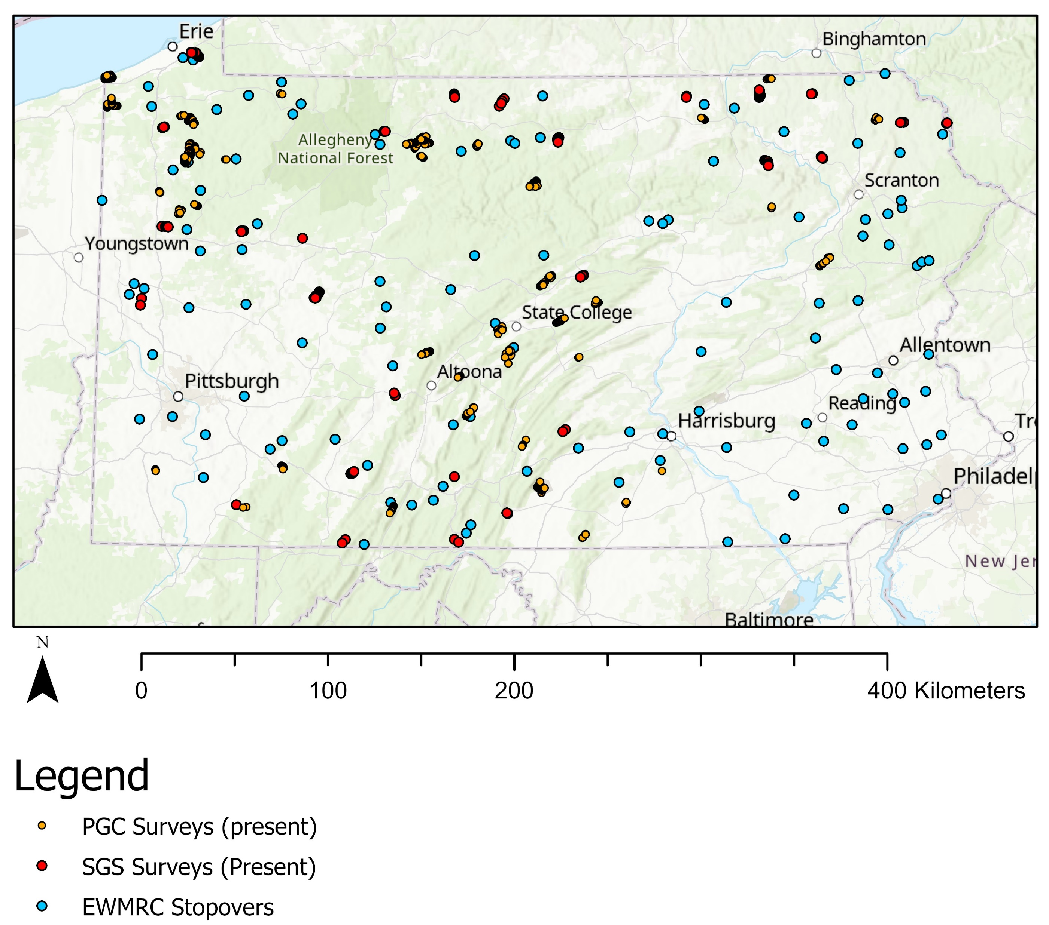
Modeling strategy
Migratory data
Eastern Woodcock Migratory Research Cooperative
Residential data
Singing Ground Survey, Pennsylvania Game Commission surveys
Modeling technique
Random Forests
Implemented in R

Slide 4
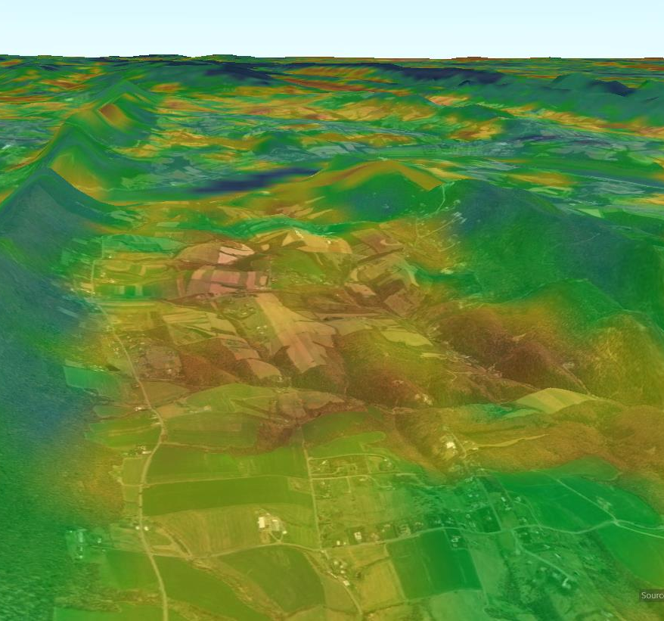
Predictive Variables
Topography
Soil Moisture
Land use/land cover
Fragmentation

Slide 5
How do we weight migratory and residential models?
Is migratory or residential habitat more important to agency objectives?
Decision is left up to the user
Ex. 90% residential, 10% migratory

Slide 6
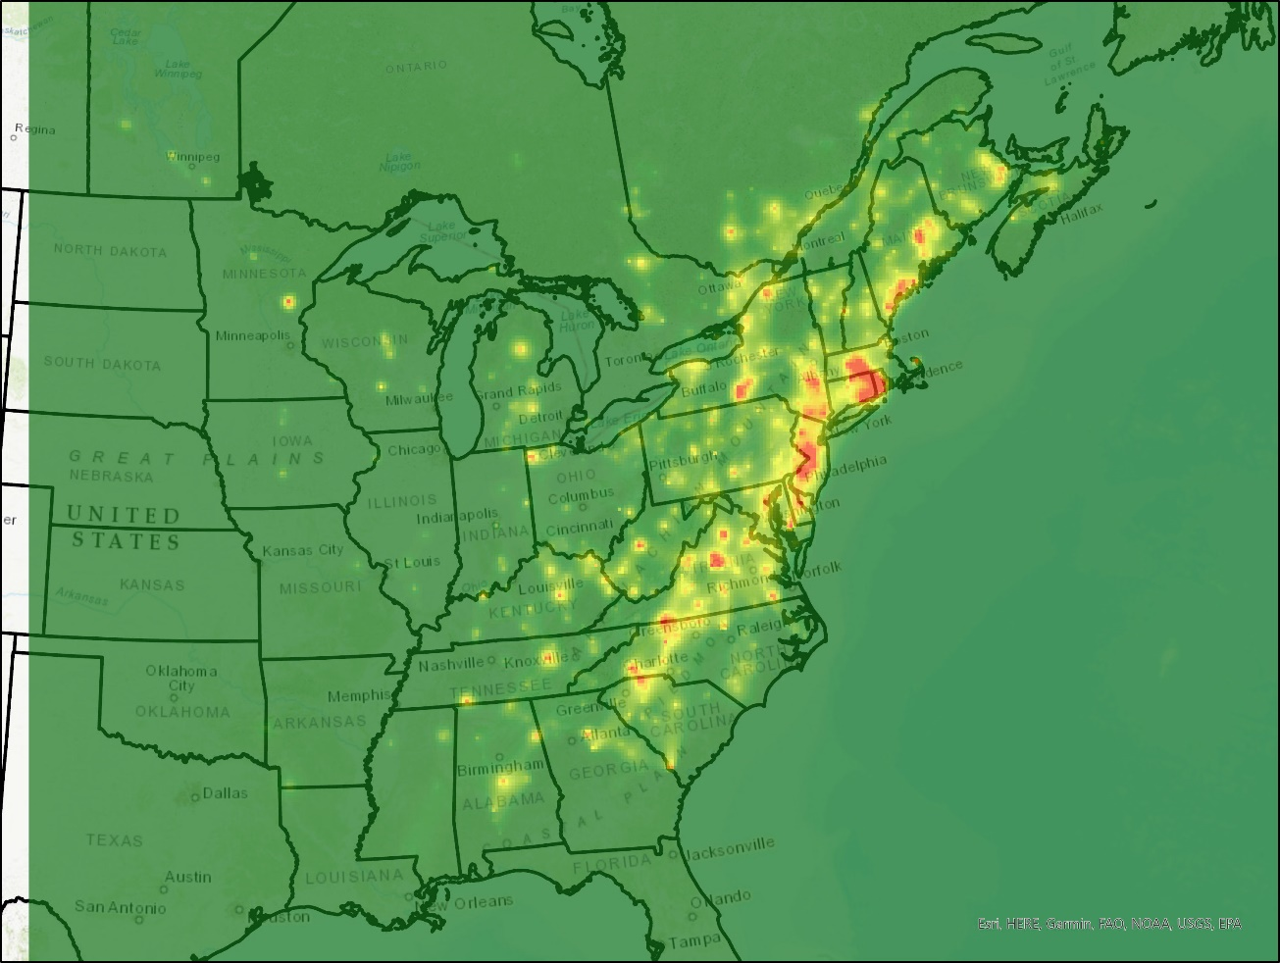
How do we weight migratory and residential models?
Weighting decisions can be made at a state agency level, a management region level, or a local level
Considerations might include:
Woodcock migratory corridors
Breeding season population objectives
Spring Migration

Slide 7
W-PAST beta is available
https://woodcock.shinyapps.io/woodcock_weighted_habitat
Technical report & user guide are being written now
Planned deployment ahead of habitat management in Spring 2022

Slide 8
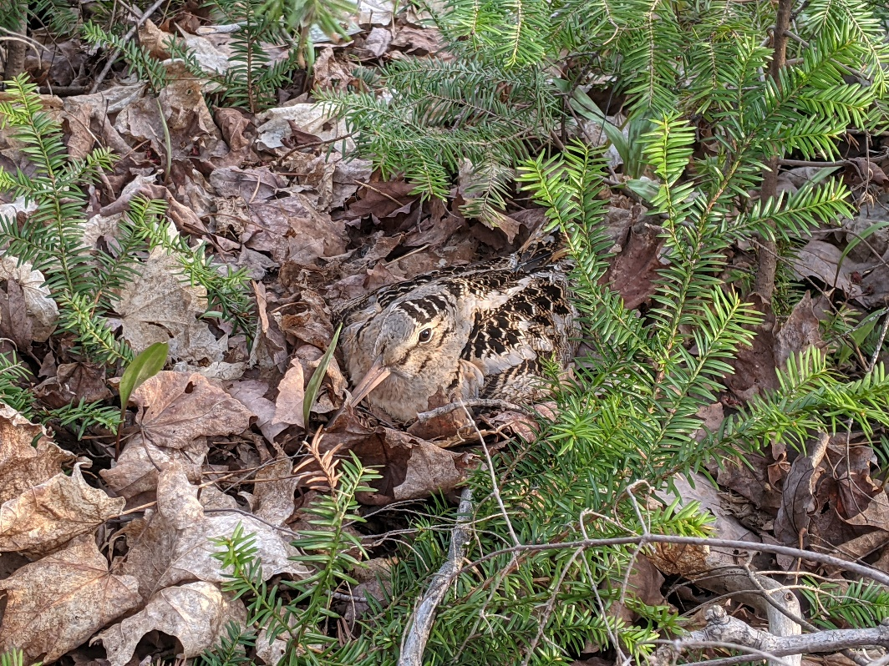
Next Steps
Protected/unprotected land use
Resource selection throughout full annual cycle
Migratory connectivity patterns
Light pollution
Mat Tetreault, CWS

